Slide 1
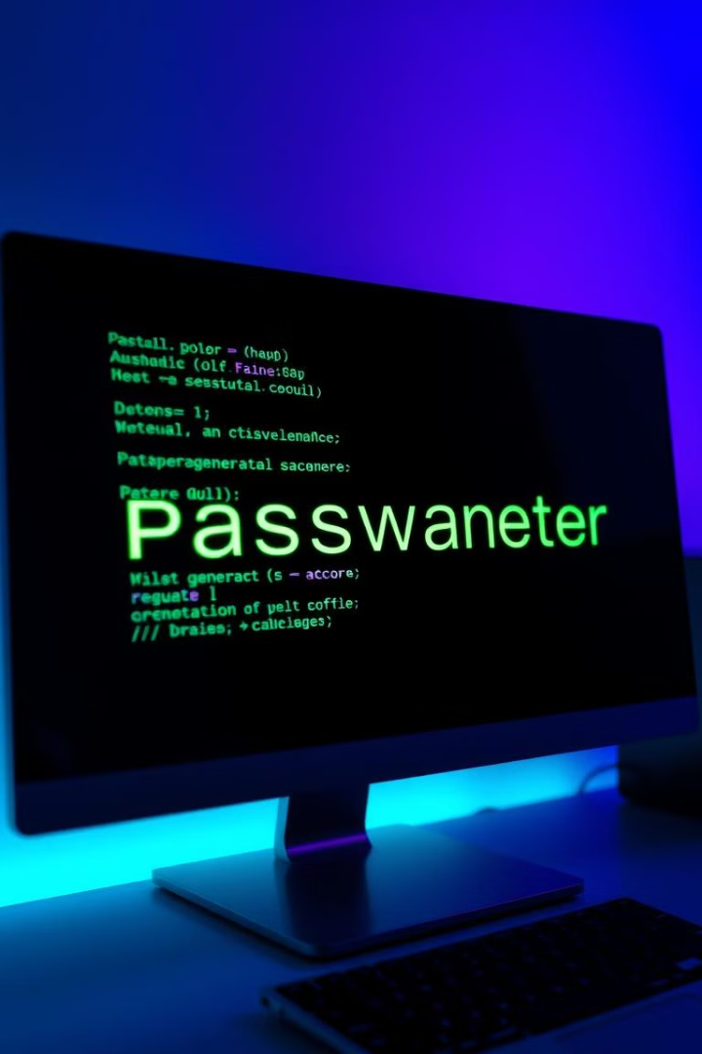
Building a Password Generator in Python
In this presentation, we'll explore the process of building a simple yet effective password generator in Python. We'll cover the fundamental concepts, the importance of secure password generation, and the practical steps involved in creating a functional tool.

Slide 2
Why Create a Password Generator?
Security
Complexity
Weak passwords are a primary vulnerability in cybersecurity. By creating strong, unique passwords, you can significantly reduce your risk of unauthorized access to your accounts.
Modern systems often require long, complex passwords, making it difficult to remember and manage them all manually. A password generator automates the process, making it easy to generate secure and unique passwords.

Slide 3
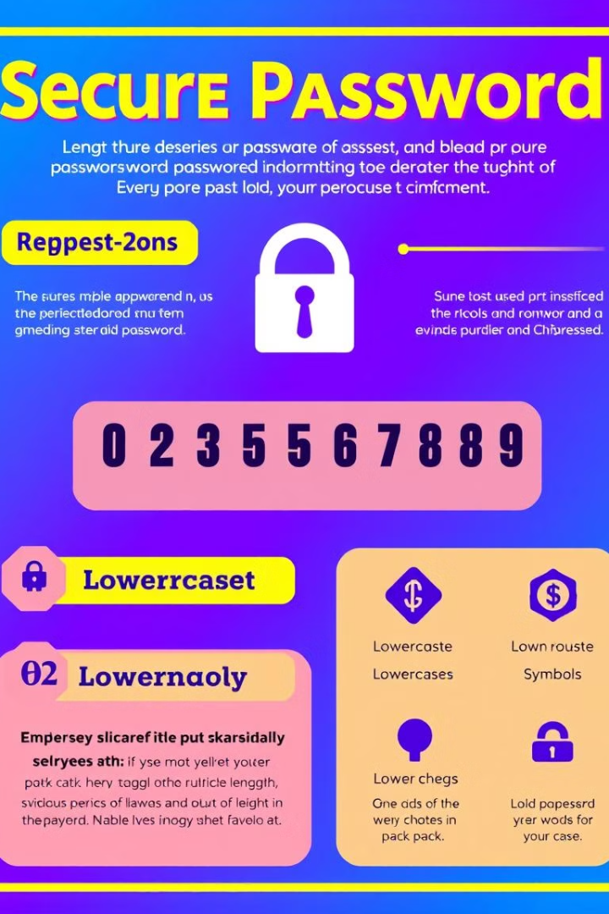
Key Requirements for a Secure Password
1
Length
2
Variety
Longer passwords are harder to crack. Aim for at least 12 characters, ideally more.
Incorporate a mix of uppercase and lowercase letters, numbers, and symbols. This increases complexity.
3
Uniqueness
4
Regular Updates
Use a different password for each account. Avoid using personal information that can be easily guessed.
Update your passwords regularly, especially if you suspect a breach.

Slide 4
Building the Password Generator Step-by-Step
Import Modules
1
Start by importing the necessary modules, such as "random" for generating random characters.
2
Define Character Sets
Create separate sets for uppercase letters, lowercase letters, numbers, and symbols. This allows for greater control over the password composition.
Generate Random Characters
3
Use the "random.choice()" function to select random characters from the defined sets. This step forms the core of the password generation process.
4
Combine Character Sets
Concatenate the randomly generated characters into a single string, ensuring a balanced mix of character types.
Password Length and Complexity
5
Define the desired length and complexity level for the password. This can be done by specifying the number of characters from each set.

Slide 5
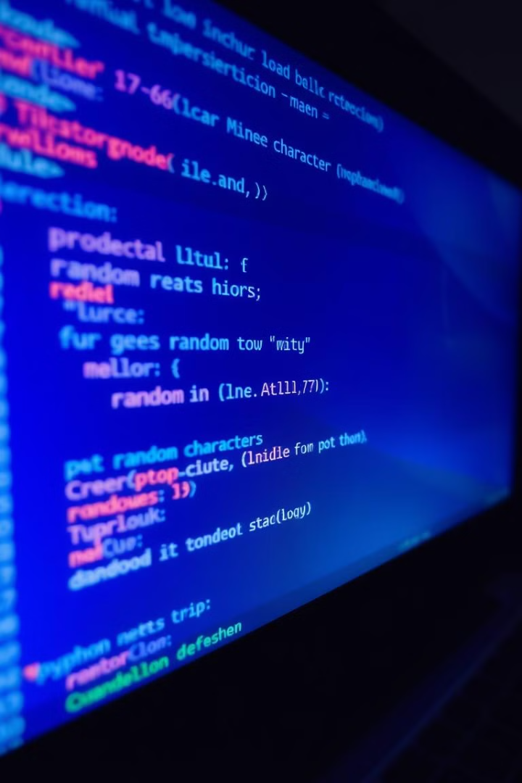
Generating Random Characters
import random lowercase = "abcdefghijklmnopqrstuvwxyz" uppercase = "ABCDEFGHIJKLMNOPQRSTUVWXYZ" numbers = "0123456789" symbols = "!@#$%^&*()" password = "" for i in range(12): password += random.choice(lowercase + uppercase + numbers + symbols) print(password)

Slide 6




Combining Character Sets
Uppercase Letters
Lowercase Letters
Numbers
Symbols
Ensure at least one uppercase letter for added security.
Include lowercase letters to make the password more human-readable.
Add numerical characters for increased complexity.
Incorporate symbols for an extra layer of security.

Slide 7
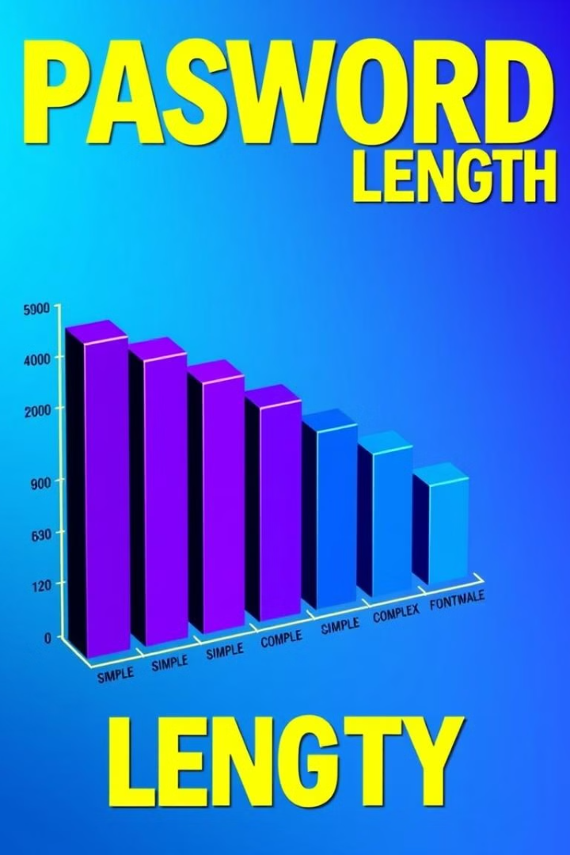
Password Length and Complexity
12
4
Length
Complexity
Aim for a password length of at least 12 characters, preferably more.
Use a mix of at least four different character types for maximum security.

Slide 8
Conclusion and Next Steps
Security Enhancement
1
Enhance the generator's security by incorporating a stronger random number generator.
Customizability
2
Allow users to customize the password length and complexity levels.
Integration
3
Integrate the password generator into a broader security system, such as a password manager.

Slide 9

Thank You!
This presentation has provided an introduction to building a password generator in Python. Feel free to ask any questions or discuss further improvements for this tool.

